Slide 1

COLLAGE MANAGEMENT SYSTEM
DATA STUUCTURE AND ALGORITHM(JAVA)
Group Members:
1:Mohammed Numair(CSE 353)
2:Mohammed Reyhan(CSE 354)
3:Alpansh Sharma(CSE 356)

Slide 2
Project Overview
Dynamic Data Management
College Management System handling student data efficiently using Java and Singly Linked List for dynamic memory management.
Key Attributes
Manages Roll Number, Name, and Attendance Percentage for each student record.
Flexible Storage
Students added without fixed array size limitations.

Slide 3
Technical Features
Data Structures
Linked List for addStudent() operations
Linear Search for finding students by Roll Number
Bubble Sort for attendance-based sorting
Performance
Insertion operates in or time complexity.
Linked List
Dynamic node-based storage
Linear Search
Sequential traversal by Roll Number
Bubble Sort
Attendance-based ordering

Slide 4
Operation 3: Sorting by Attendance
Count Nodes
Traverse list to determine array size needed
Copy to Array
Transfer linked list data to Student array
Bubble Sort
Compare adjacent elements, swap if out of order
Display Results
Print sorted list from lowest to highest attendance
Sorting Logic
for (int i = 0; i < count - 1; i++) {
for (int j = 0; j < count - i - 1; j++) {
if (A1[j].attendance > A1[j + 1].attendance) {
Student temp = A1[j];
A1[j] = A1[j + 1];
A1[j + 1] = temp;
}
}
}

Slide 5
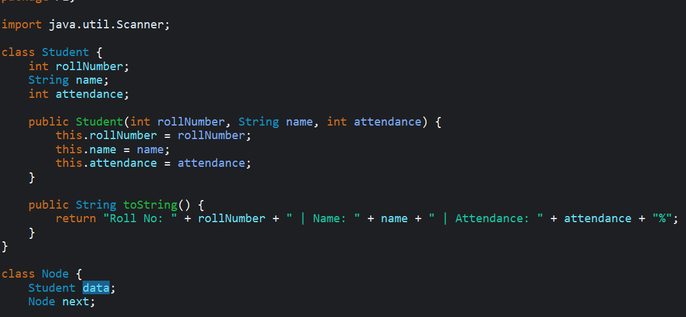
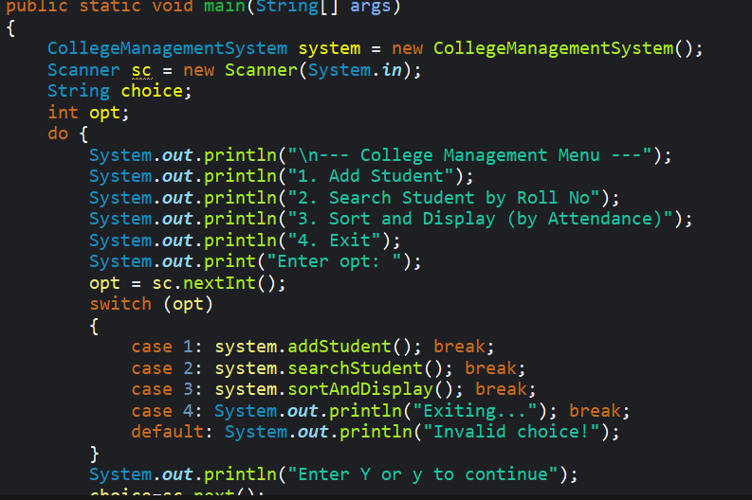
CODE SCREENSHORT

Slide 6
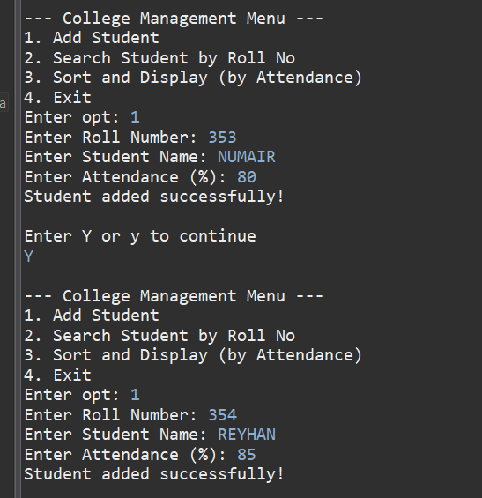
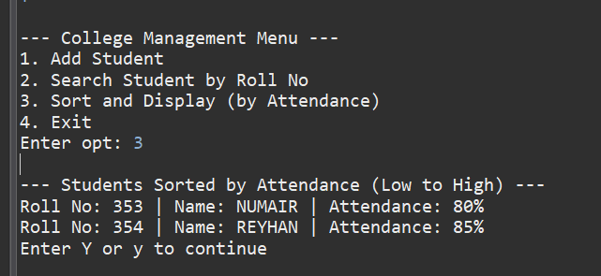
OUTPUT SCREENSHORT

